Slide 1
Towards Precise Detection of Toxic Pharmaceutical Drugs using Vision Transformers
Presenters: Derek Nguyen, Oghenetega Erekata,
Richard Park, Yogesh Kulkarni

Slide 2
Agenda
Introduction
Related Work
Data
The Pill Classification Model
Result
Final Remarks

Slide 3
Introduction

Slide 4
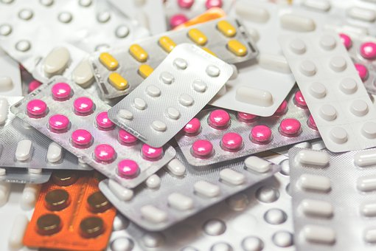

Background Information/Motivation
Pharmaceutical medications have preserved the health of all persons in modern civilization
Over 20,000 prescription drug products approved by the FDA
Have possible side effects that can be harmful, even poisonous, to the health of some people
Difficult for non-specialists to identify prescription pills
US intellectual-property law: allows a single drug to have different appearances
Adverse drug events - harm caused by pharmaceutical use - cause more than one million visits to hospital emergency rooms each year
According to a WHO report, one-third of all mortality is caused by the misuse of drugs, not by disease
Our project addresses the SDG of Good Health and Well-Being by identifying potentially toxic pharmaceutical drugs through image classification

Slide 5
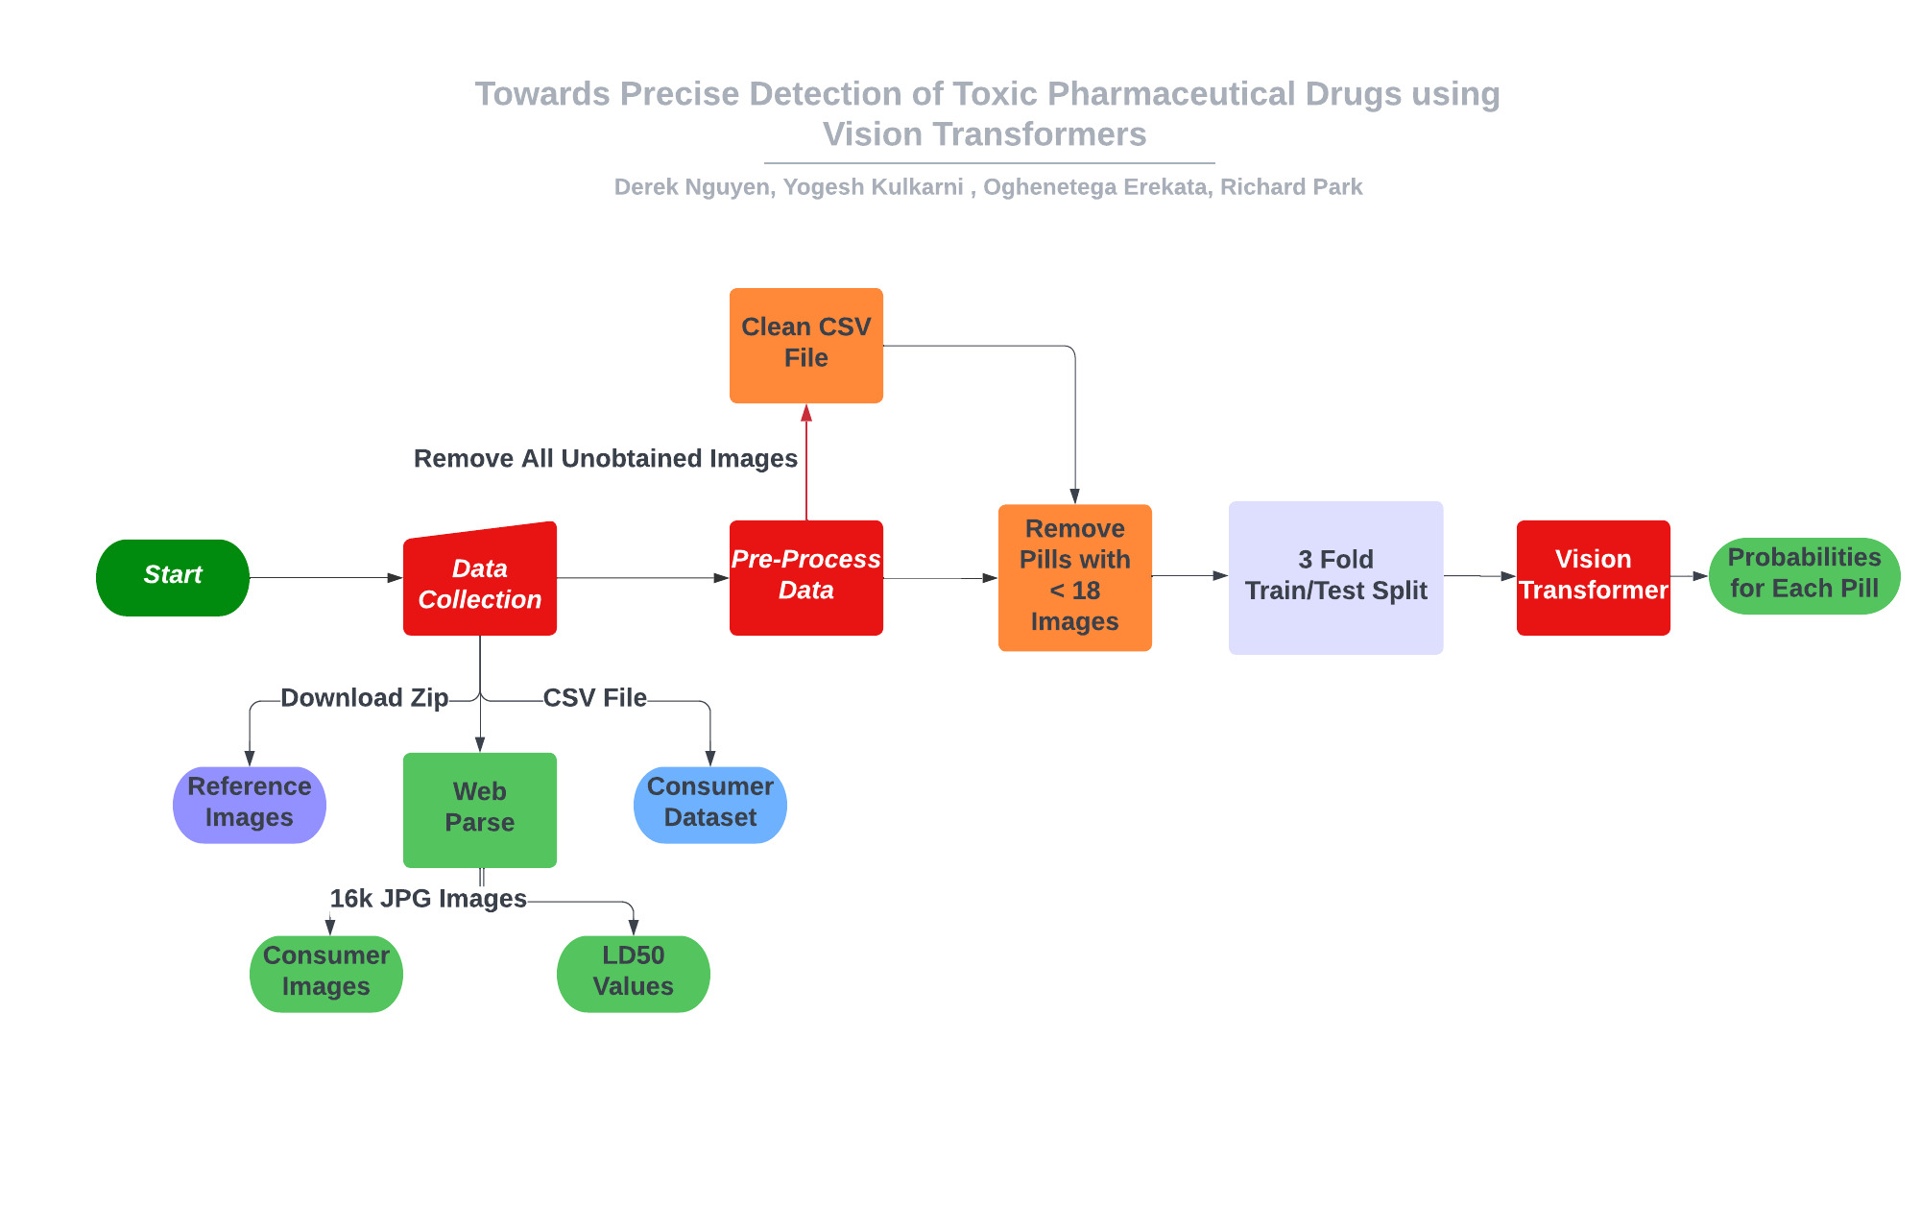
Plan Idea

Slide 6
Related Work

Slide 7
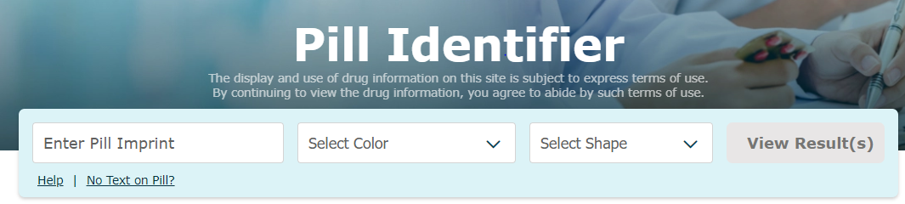
Previous research works
Industrial Websites
WebMD
Pros
Provide functionalities to identify pills
Cons
Use textual inputs such as the pill’s color or shape
In the academic literature, several groups have addressed the challenge of pill classification and they share a common theme: the use of feature vectors designed based on domain knowledge with ranking based on the distances between the feature vectors of the reference images and consumer images

Slide 8
Previous research works
The National Library of Medicine established the Pill Image Recognition challenge of 2014 revitalized research in the area of Pill recognition.
The goal of the challenge was to develop high-quality algorithms and software to rank how closely consumer photographs of prescription medications match high-quality reference images of pharmaceuticals.
Three teams won the challenge, obtaining average precision scores of 0.27, 0.09, and 0.08.
Two of them used deep-learning techniques; one used Convolutional Neural Network and the other used Convolutional Neural Network and SIFT(Scale-Invariant Feature Transform) descriptor algorithm.
Also, Sousa et al., in 2019, attempted image classification on the same dataset, using image processing techniques to extract shape and color features and then pill identification using Support Vector Machines (SVM). Recorded accuracy of 99.3%, but only performed classification on the high-quality image, and classification was only on pill form—capsule, oval or round.

Slide 9
Expanding on previous works
More dataset than the one used during the challenge: The challenge had 2000 reference images and 5000 consumer images, but now has ~4000 reference images and ~133000 consumer images.
Advanced neural network architectures to tackle the problem, one of which is the Vision Transformer (ViT) architecture.
ViT was introduced in 2020 in the paper An Image is worth 16X16 words: Transformers for Image recognition at scale.
It was inspired by the transformer scaling success in NLP.
Can we apply its “object in interest attention mechanism” to our problem?

Slide 10
Data

Slide 11
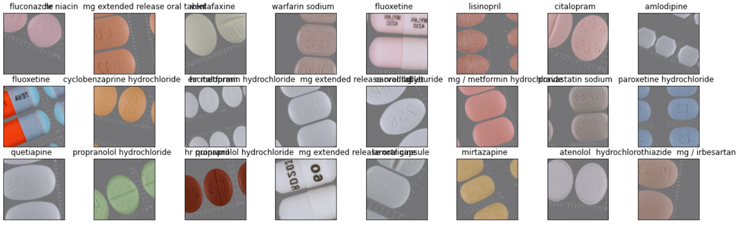
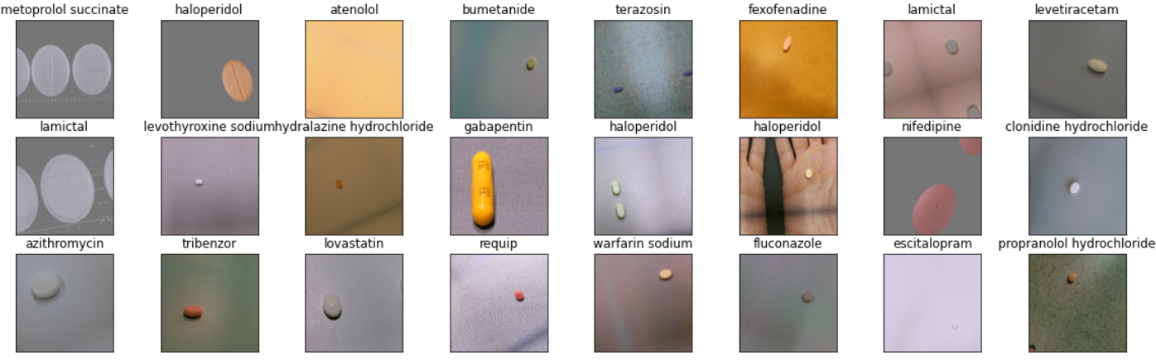
Dataset: Pill Image Dataset
We used two datasets for our project: the National Library of Medicine Pill image dataset and a dataset of LD-50 reading
The National Library of Medicine Pill Image dataset consists of over 4,000 Reference Pill Images (high-quality images taken under controlled lighting conditions) and over 133,000 Consumer Pill Images (lower-quality images that mirror what one might expect in the real world).
Originally, the Reference pill images contained 200 number of classes, and the Consumer pill images contained ~1000 number of classes.
Due to memory constraints, we couldn't download all the consumer images, so we ended up downloading all 4000 of the Reference images containing images of 200 classes and 16k of the Consumer images containing images of 230 classes.
Due to insufficient images for some classes, we set a threshold of 18 for the Consumer images and 10 for the Reference images. This resulted in 8,782 Consumer images consisting of 230 classes and ~2000 Reference images consisting of 117 classes for our training.
Reference Pill Dataset
Consumer Pill Dataset

Slide 12
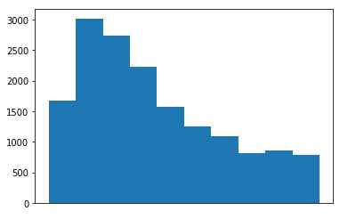
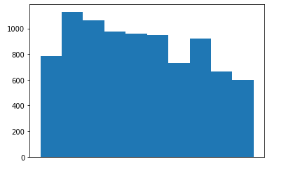
Histogram of Dataset distribution
Consumer Dataset Image Distribution:
Consumer Dataset w/o Threshold
Consumer Dataset with Threshold

Slide 13
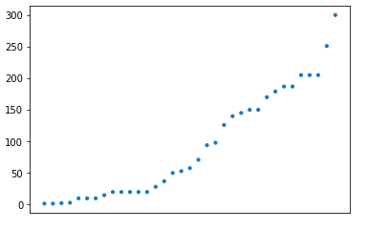
Dataset: LD-50 dataset
The LD50, which stands for Lethal Dose 50, is the quantity of a drug required to kill half of an animal test population.
We compiled the LD50 dataset by scraping the go.drugbank.com website (a comprehensive online database containing information on drugs and drug targets). For the drugs we couldn't find on the page, we searched the web for their LD50 values.
We also ensured that the LD50 values were in mg/kg, and since LD50 values exist for different animals, we chose to use only the values for rats and mice.
We grouped drugs into toxic drugs and non-toxic drugs using their LD50 values. We considered drugs with LD50 lower than 300mg/kg as toxic drugs and drugs with values above as non-toxic drugs.
In the consumer dataset, we ended up with 30 classes of toxic drugs and 200 classes of non-toxic drugs.
We used this categorization to quantify how well our classifier is doing. (More on this later.)
LD50
Pill labels
Notes:
We chose LD50 because it's being used in the pharmaceutical business to assess the acute risks of tablets, especially when no other toxicity data is available.

Slide 14
Building the Pill Classification Model

Slide 15
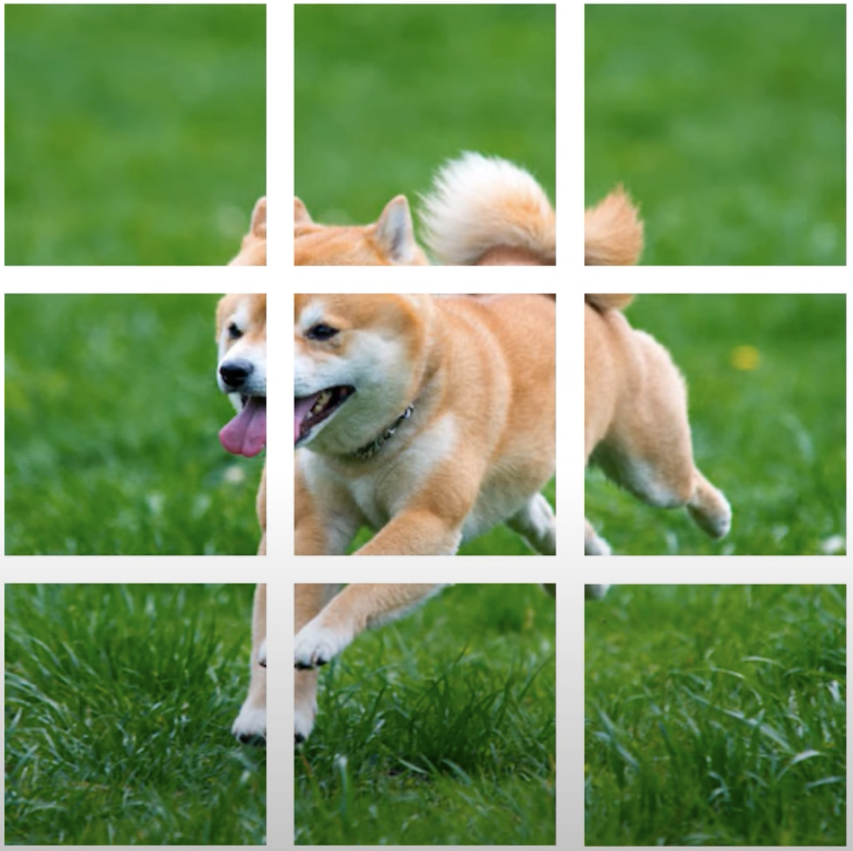
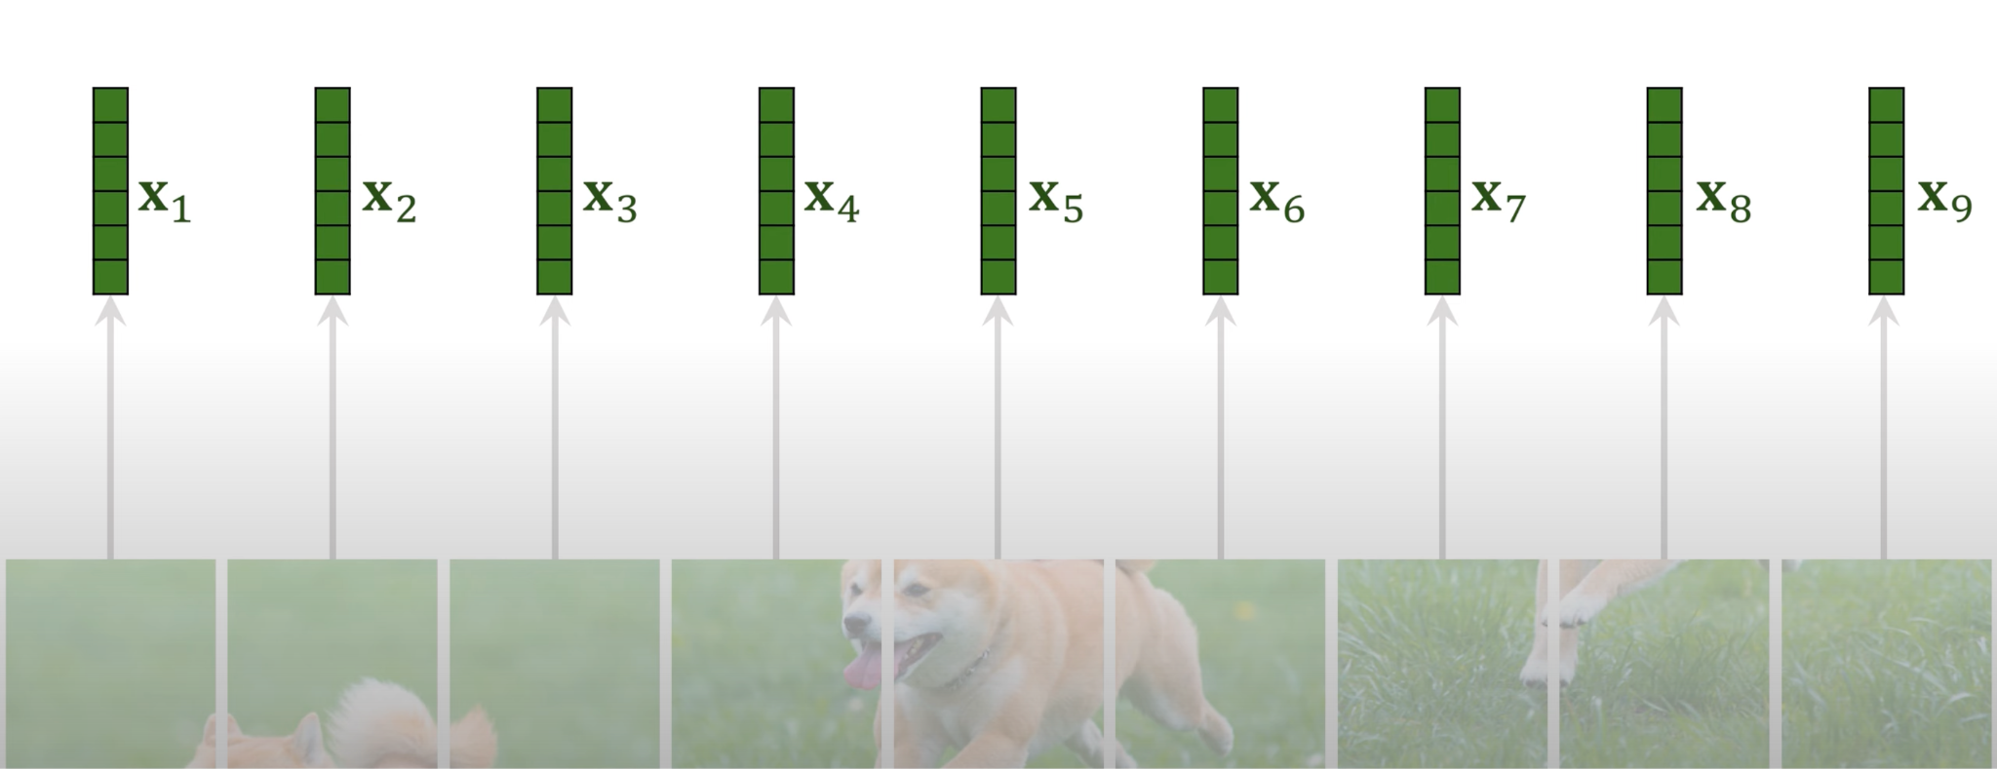
ViT
Choose a patch size
Vectorize each patch

Slide 16
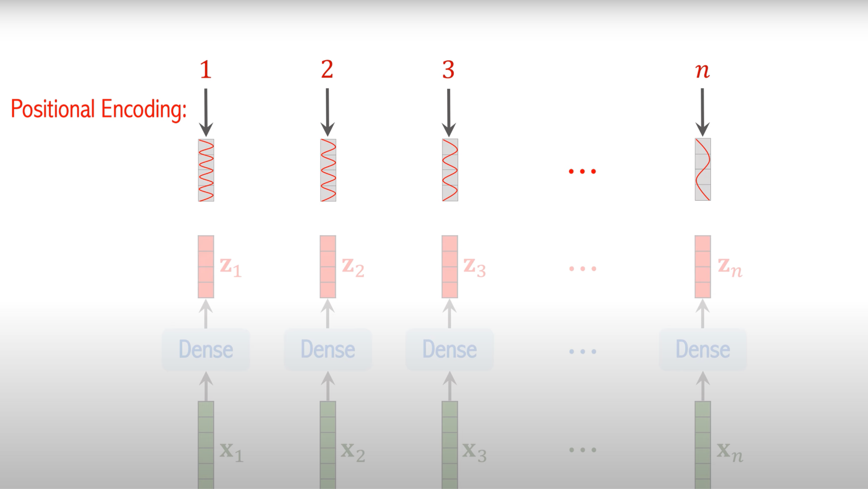
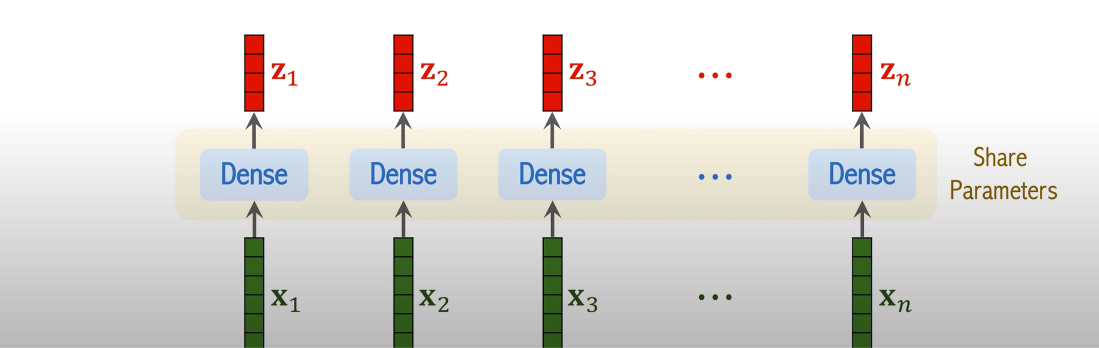
ViT
Linear embedding for each patch
Add positional encoding to the linear embeddings

Slide 17
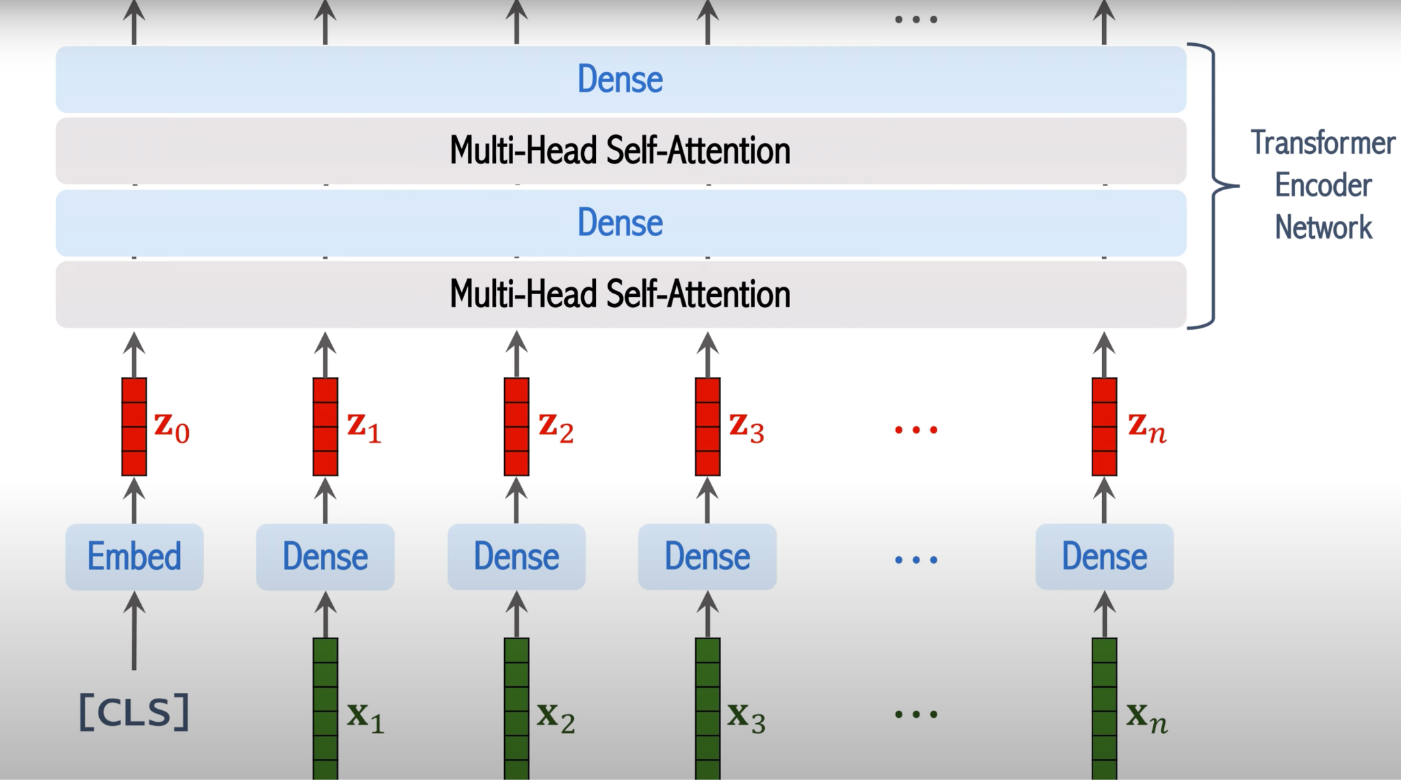
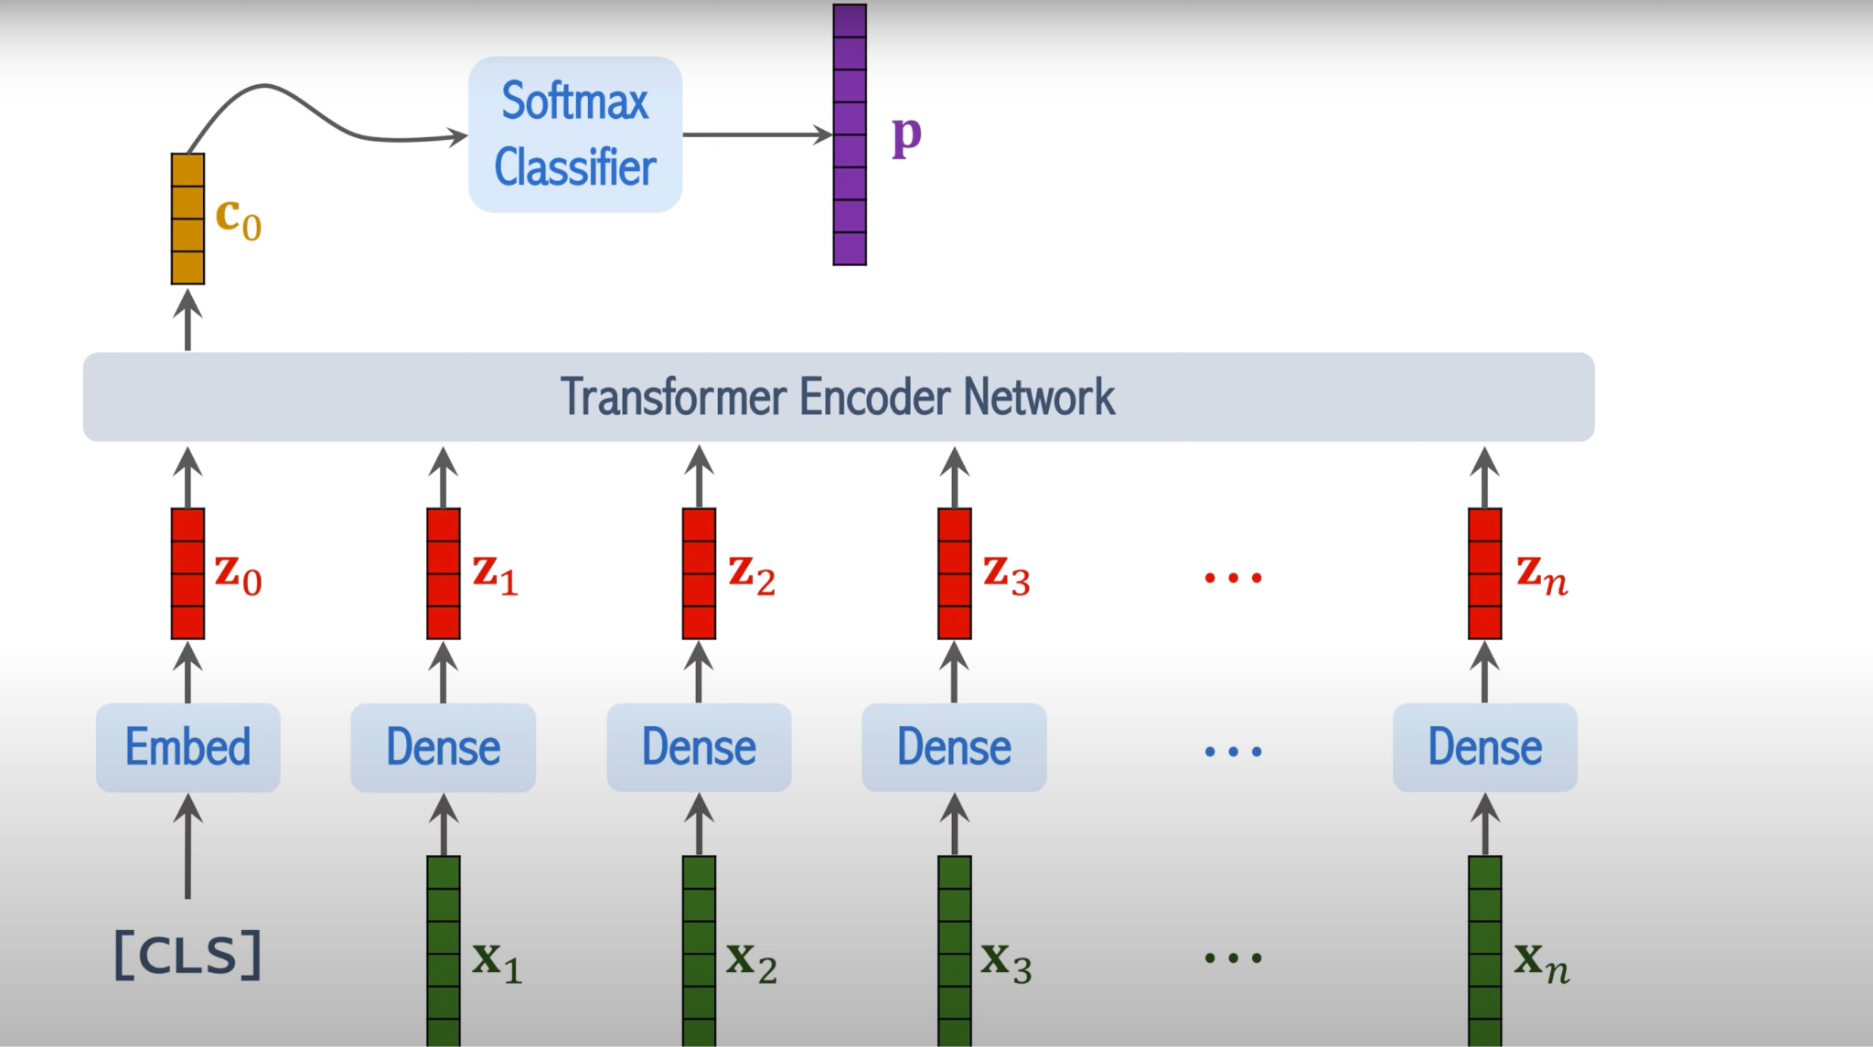
ViT
Multiple self-attention layers
Softmax classifier on the last layer

Slide 18
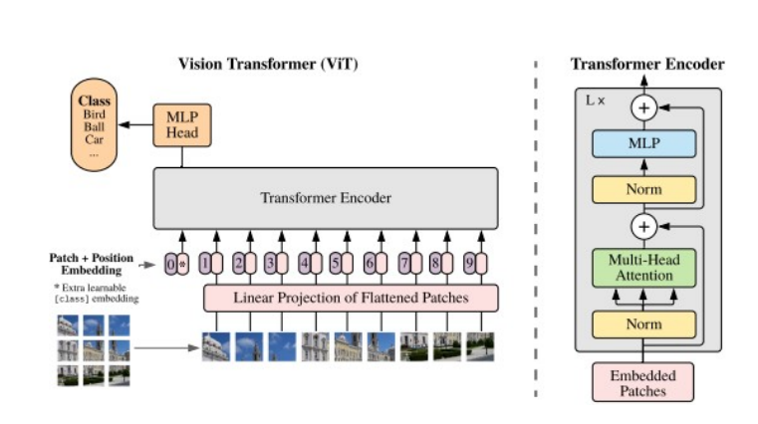

Slide 19
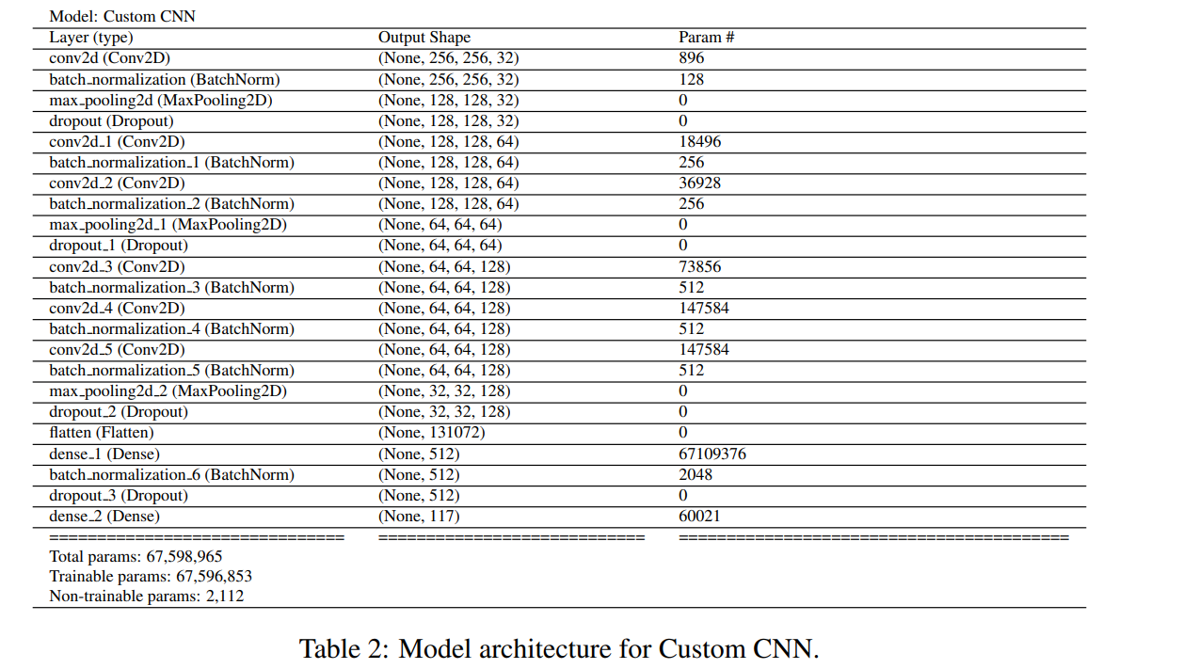
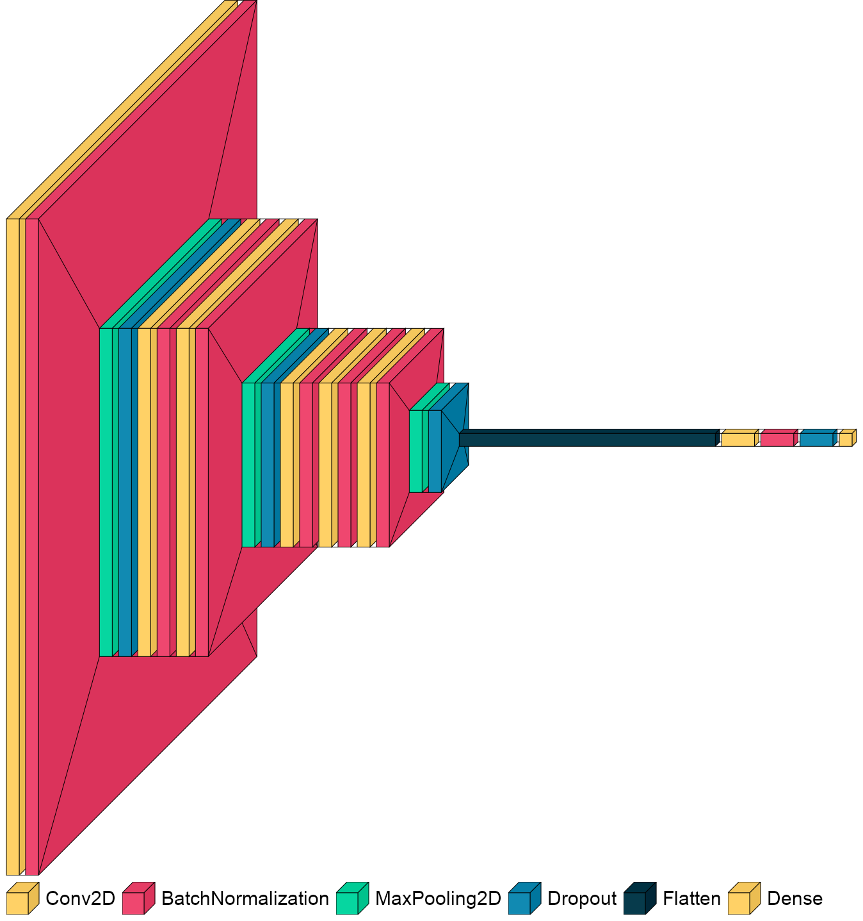
Custom CNN

Slide 20
The Training and Evaluation Setup
Train on 6586, validate on 2196 -> 230 classes
3 fold cross validation (fixed random seed)
Augmentations (Albumenations):
Horizontal flip
ShiftScaleRotate
Normalization
Adam (weight decayed) optimizer
Learning rate scheduler
Early stopping

Slide 21
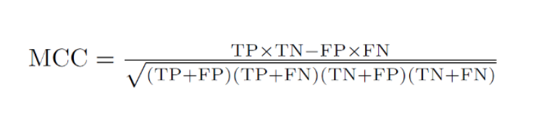
Beyond Precision/Recall
Matthews Correlation Coefficient (MCC)
Takes into account all four values of confusion matrix
High value –> All classes predicted well despite over/under representation
Grave Mistakes
How many toxic pills classified as non-toxic

Slide 22
Result

Slide 23
Results (averaged over 3 folds) [Reference]
Model | Precision | Recall | F1 | MCC | GM (218) | #Param
Custom CNN | 0.52 | 0.45 | 0.44 | 0.47 | 71 | 67M
EffNet | 0.55 | 0.53 | 0.50 | 0.50 | 46 | 4.1M
1,439 (train), 480 (val), 117 classes

Slide 24
Results (averaged over 3 folds) [Consumer]
Model | Precision | Recall | F1 | MCC | GM (837) | #Param
Custom CNN | 0.00 | 0.01 | 0.00 | 0.01 | 809 | 67M
EffNet | 0.09 | 0.11 | 0.08 | 0.09 | 654 | 4.1M
ResNet50 | 0.14 | 0.14 | 0.11 | 0.12 | 591 | 40M
ConvNeXt | 0.33 | 0.30 | 0.28 | 0.29 | 213 | 20M
Swin | 0.38 | 0.32 | 0.31 | 0.32 | 204 | 18M
ViT | 0.50 | 0.45 | 0.44 | 0.46 | 171 | 76M
6,586 (train), 2,196 (val), 230 classes

Slide 25
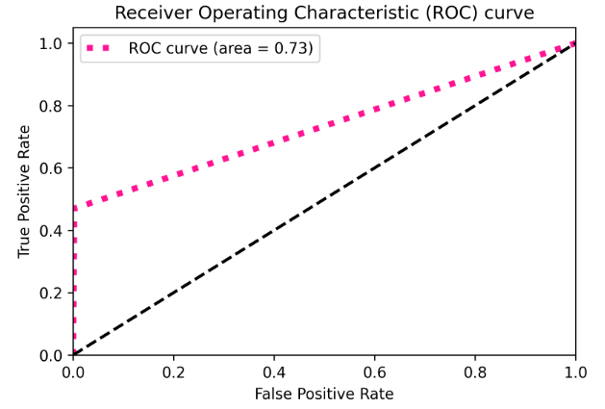

Slide 26
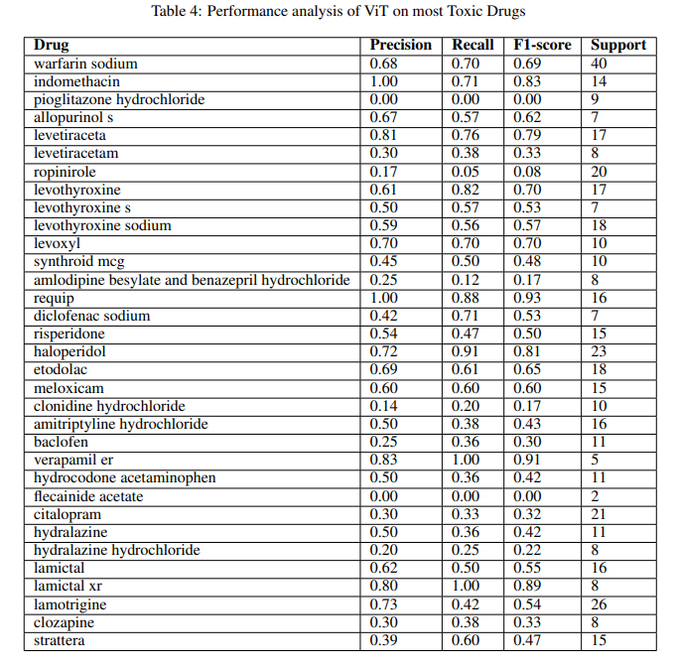
Results on Toxic Drugs
Most toxic drug warfarin sodium, performed with a recall of 0.70
Pioglitazone hydrochloride, the model failed to predict any sample correctly
Reasoning: Class imbalance/Poor image

Slide 27
Interpretability

Slide 28
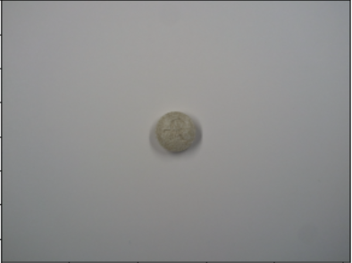
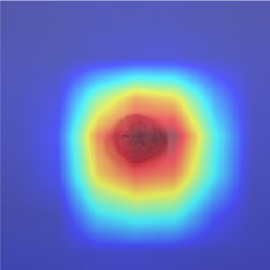
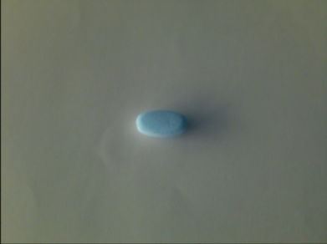
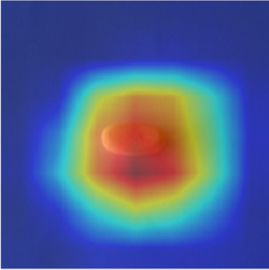
Grad-CAM - Camera for your Deep Learning model’s decision
Want to understand which part of image was important for classification.

Slide 29
Final Remarks

Slide 30
Review/Analysis:
Image data highlights very glaring issues in the pharmaceutical drug industry
Most pills had little identifying characteristics
Ability to identify pills with visually similar characteristics
Visual based assistance system.
Data and compute power drives everything
Extensions:
More data → better models
Try imbalance class favoured loss functions (focal loss)
One-shot learning

Slide 31
Questions?

Slide 32
Thank You!

